Slide 1
Intercultural Concept
Students will create an individual PowerPoint exploring/examining an intercultural concept.
View the List of Possible Concepts.
The PowerPoint presentation should act as a stand-alone project. All the required information should be included on the slides.
Introduce your topic creatively in the first slide(s).
This first part of the PowerPoint should also include a literature review. In the literature review, students need to define and explain the major concept(s) under study with a minimum of three outside and scholarly sources (e.g., books, journals – NOT unknown websites, dictionaries). Cite your sources on slides that contain information gathered from your research. Make sure to use in-text citations when defining key terms.
The PowerPoint should also contain a thesis statement. The thesis is the main idea of your project. A thesis is an interpretation of your concept, not the concept itself. It is making an argument.
The remainder of the project/slides should illustrate and support the thesis by using evidence gained through further research.
A big difference between a power-point project and simply writing a paper is creativity. Power-point projects should contain a strong mix of text and images. Many successful past projects included embedded video and hyperlinks to further illustrate the main points.
Include a slide with your sources in APA or MLA format. This project should be at least 25 slides (not including the sources).
SAMPLE: xenophobia20.pptxActions
PowerPoint Grading Rubric Clearly/Creatively Introduced Concept/Topic | 0-2 points
Literature Review (Scholarly articles, proper APA or MLA format, [https://en.wikipedia.org/wiki/APA_style ] Thorough information / Solid explanations & definitions, minimum 3 sources) | 0-6 points
Thesis statement clearly stated after literature review | 0-2 points
Concept clearly, continuously, and creatively illustrated by using evidence gained through further research (cited sources, provided specific examples to support general statements), provided a mix of text and images, effective narrative (power-point stands on its own - no vocal explanation needed) | 0-8 points
Met minimum slide requirements and error free (solid grammar) | 0-1 points
Include a bibliography in proper MLA or APA (if credible websites are used - included full citation w/ URL) | 0-1 points
TOTAL | 20 points
https://en.wikipedia.org/wiki/MLA_Handbook

Slide 2
Assimilation
Judy R. Johnson
Submitted for Project 1 of CMST 205 3408B893 D
Culture Concept

Slide 3
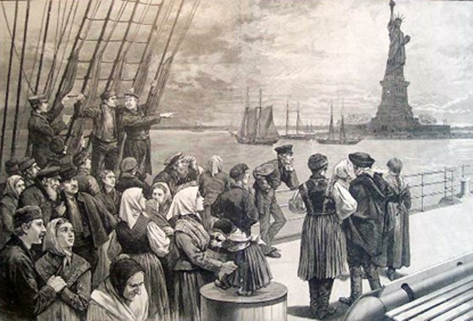
Welcome
Colonists, immigrants, slaves, indentured workers, and refugees have been arriving in what is now the United States since the 16th Century. What next?
Assimilation or rejection. Prejudice.
What does it take to make this land into home, to convert a person’s everyday frame of reference away from the “Old Country” into unthinking acceptance of here and now?
An illustration of immigrants on the steerage deck of
an ocean steamer passing the Statue of Liberty from
Frank Leslie’s Illustrated Newspaper, July 2, 1887.
National Park Service, Statue of Liberty NM

Slide 4
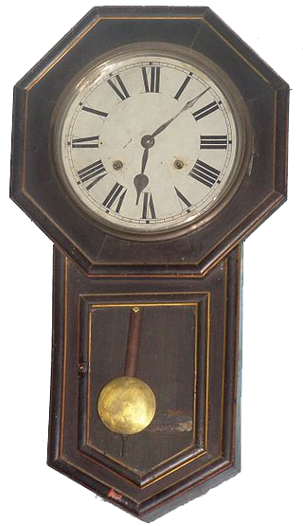

Assimilation of Immigrants
Generally, the more generations pass, the greater the assimilation, both as to acceptance with ever-lessening prejudice by the current population, and the increasing feeling by newcomers of being at home.
Is the current widespread interest in genealogy and DNA ancestry testing a manifestation of a cultural pendulum? Most who do this are proud of their once-scorned immigrant ancestors.
https://en.wikipedia.org/wiki/Pendulum_clock

Slide 5
There has been a good deal of scholarly research into assimilation, as shown in the Literature Review Example No. 2, but as much as possible this presentation will focus on the presenter’s family history of assimilation — a demo. Some highlights:
Edward Perry —
of Bridford, Devon
Mary Freeman
of London
Richard Stout — Penelope Van Princis
Married about 1643 in New Amsterdam
Married 1653 in Sandwich, MA
Isaiah Stout — Catherine Kennedy
Married 1773 in Ringoes, NJ
Robert Knowles Perry — Nellie Louise Young
Married 1883, living in Cimarron
(aka “No Man’s Land” now Oklahoma Panhandle)
George Walter Stout — Bernice Burhans
Married 1912 in New York, NY
Arthur Choate Perry — Lucile Smith
Married 1917 in Kansas City, MO
George Walter Stout II — Janet Perry
Married 1943 In Hollywood, CA
Judith Robert (Stout) Johnson

Slide 6
Literature Review – 1st example
In the 1600s, the European countries doing the colonizing often offered land patents or grants to those who would organize a new settlement, recruiting artisans and craftsmen and guards contracted to work for a time and thereafter be able to obtain land of their own. My friend Rob who compiles genealogy records has found that the Stout branch of my ancestry has two notable examples deriving from The Netherlands. One has to do with a family among the colonists sponsored by Cornelis Melyn.
Cornelis Melyn (1600 – c. 1662) was an early Dutch settler in New Netherland and Patroon of Staten Island. He was the chairman of the council of eight men, which was a part of early steps toward representative democracy in the Dutch colony.
https://en.m.wikipedia.org/wiki/Cornelis_Melyn

Slide 7
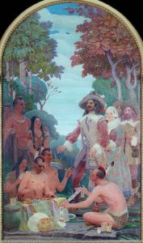
Literature Review – 1st example (continued)
Melyn's role in history is recognized in a mural in the Staten Island Borough Hall by Frederick Charles Stahr entitled Cornelius Melyn Trades With the Indians.[
“A major portion of Staten Island is granted to Melvin on 1641 by the Dutch West Indies Company. Between 1641 and 1655, colonies are continuously destroyed by Native Americans in conflict over the polices of the Dutch Governor General.”
After the Peach Tree War, Melyn and family left for the English New Haven Colony, where he took an oath of allegiance to the English crown April 7, 1657. In 1659, he agreed with the West India Company to relinquish his right of Patroonship of Staten Island but was so capable that he became a prominent public servant for the British.

Slide 8
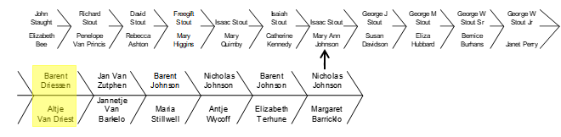
Literature Review – 1st example (continued)
In 1655, one of Melyn's colonists caught an Indian woman stealing a peach from his trees, and shot her dead; …this helped to ignite the “Peach Tree War,” where dozens of colonists were massacred and Melyn ransomed his family and the other survivors.
In one of these Indian attacks my ancestor, Jan Van Zutphen, was left orphaned. His descendants changed their last name to “Johnson” as (Dutch) New Amsterdam became (English) New York and the family sought to assimilate. Mary Ann Johnson changed the Stouts from Baptists into pillars of the Dutch Reformed Church in NewJersey.

Slide 9
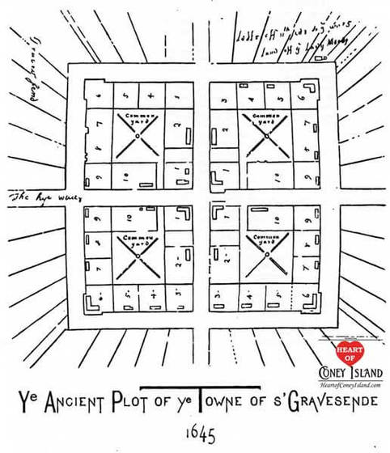
The Stout Patriarch
Richard Stout apparently first served as a mercenary officer for the Dutch in New Amsterdam, then for the Coney Island settlement of Lady Moody in Gravesend (Brooklyn, NY). “The land grant was given to thirty-nine principals among Lady Moody's group, among them both individuals and heads of households. These principals were known as 'patentees’.”
Lady Moody was the wealthy, educated, well-connected and eminently capable widow of a baronet, Sir Henry Moody. She also was a kinswoman of Oliver Cromwell… She had settled first in Salem, MA, but held differing religious views.
http://www.heartofconeyisland.com/early-coney-island-history.html
Here, Richard Stout prospered as a patentee/landowner, and his family increased, but he struck deals with the Indians in New Jersey for large tracts of land, and the family relocated there.

Slide 10
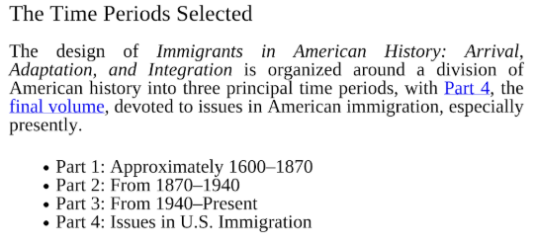
Literature Review – 2nd example
Immigrants in American history / Elliott Robert Barkan, editor, p. cm. Includes bibliographical references and index. ISBN: 978-1-59884-219-7 EISBN: 978-1-59884-220-3

Slide 11
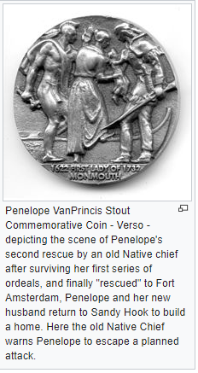
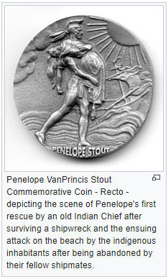
The Stout Matriarch https://en.wikipedia.org/wiki/Penelope_Stout
Literature Review – 3rd example
In 1643 ^{[3]} Penelope and her husband took a ship from the Netherlands to New Amsterdam. Their ship foundering, she and her husband and several others made land at Sandy Hook, NJ. Her husband was not able to travel and she remained with him. After the couple was abandoned, they suffered an attack from the natives and her husband was killed. She survived … and sheltered in a hollow tree until she made herself known to the Navesink tribe of Leni Lenapi. …When she was well enough …she was, perhaps sold, to the Dutch at New Amsterdam. There she married Richard Stout. They had a large family … mostly born at Gravesend in the area of Coney Island, Brooklyn.

Slide 12
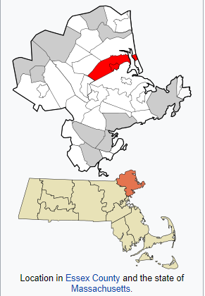
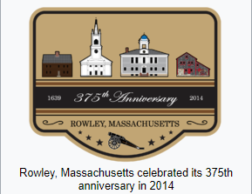
Those were examples of immigrants rejected by the native inhabitants in their new country but persevering; various other immigrants at various instances gave up and went back to the Old Countries; however, some — even most — assimilated.
Two Boynton brothers came from Yorkshire on a ship full of Puritans. The congregation founded Rowley, Massachusetts, named after their Pastor.
https://en.wikipedia.org/wiki/Rowley,_Massachusetts
But I’m pleased to note that each generation of Boyntons after that moved further away from the Puritans, who were not very tolerant or kindly.
One branch moved to Quebec to take up land grants given to English speakers by the British who won Canada from the French due to the 1763 Treaty of Paris.

Slide 13
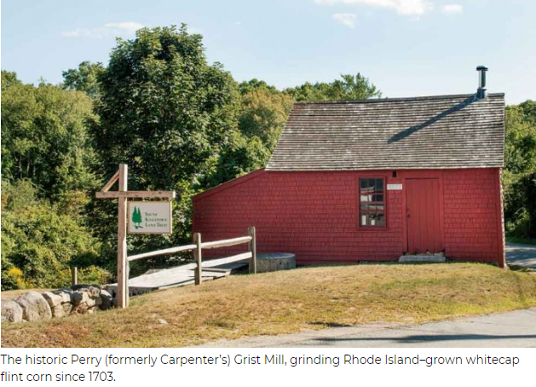
Another ancestral branch, the Perry family, settled on Cape Cod in the first place so as to avoid Puritan Boston.
They left Massachusetts for Rhode Island because of the Shannock Purchase — the Indians had sold this land. Cheap land with good mill streams were the reason for the move. The Perrys built mills, invented machinery, and refined bog iron. I visited this mill in 2013.
The Perrys were Quaker families entwined with the “Fighting Quakers,” the Hazards. Rhode Island welcomed them, but my branch is descended from a renegade who defied the pacifist Quakers and enlisted in the Continental Army; after they rejected him, he went to Connecticut and became a Presbyterian farmer.
https://newengland.com/yankee-magazine/travel/samuel-e-perry-grist-mill/
http://navalwarcollegemuseum.blogspot.com/2010/07/perry-family-of-newport.html

Slide 14
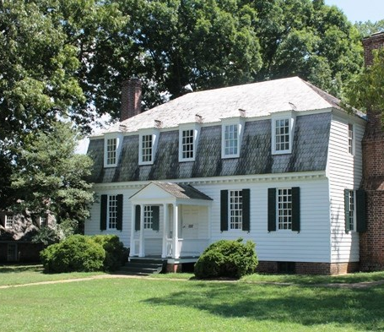
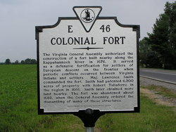
The Smith family of my grandmother traces to a younger son of a “gentry” family who immigrated as an officer serving the Governor’s expedition to Virginia. Major Lawrence Smith became a successful military leader through Indian wars and the Bacon Revolt, and his family built this home, York Plantation, where George Washington accepted the surrender of Cornwallis in 1781, thus ending active fighting in the Revolutionary War.
https://www.findagrave.com/memorial/58965935/lawrence-smith
https://www.wikitree.com/wiki/Smith-1217
https://www.nps.gov/york/learn/historyculture/moore-house.htm
https://en.m.wikipedia.org/wiki/Bacon%27s_Rebellion

Slide 15
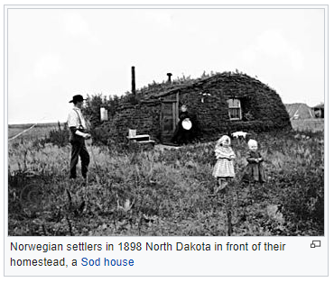
Primogeniture produced many landless younger sons. Free Land was a driving force behind voluntary immigration; there was no such thing in the Old Countries. It was difficult to even buy land except as a smallholder; land in large chunks was reserved one way or another for “The Gentry,” who kept their smaller neighbors “in their place” by fair means or foul.
Literature Review – 4th example
There’s a town on Whidbey Island in Washington State called “Freeland” and it’s not a founder’s name but a cry of exultation.
So immigrants kept coming, whether welcome or not, and subsequent generations assimilated as a natural consequence.
https://en.wikipedia.org/wiki/Homestead_Acts

Slide 16
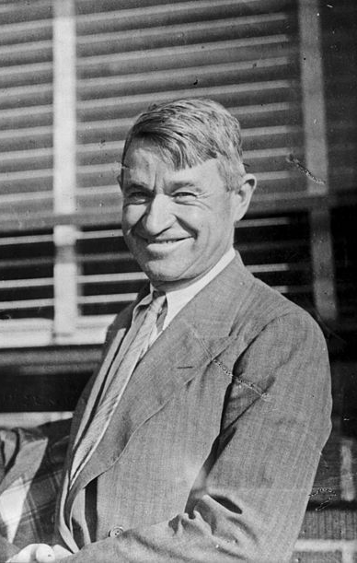
“Buy land. They ain’t making any more of the stuff.” Will Rogers (not a relative)
Will said this after most of the free land was already taken away from the Native Americans and title vested in the Immigrant owners. He meant it as investment advice.
https://en.wikipedia.org/wiki/Will_Rogers

Slide 17
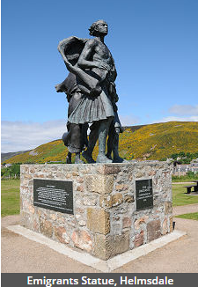
Less than voluntary immigration
Deportation from the Old Country — The Highland Clearances https://www.britannica.com/topic/Highland-Clearances
A famous Romance writer founded a museum on the East Coast of Scotland with a theme about Highlanders forcibly removed from the fertile glens so that the Lairds could more profitably raise sheep there. Most were resettled on the coasts in harsh conditions but some, it is claimed, were forced aboard ships and taken to the American colonies. If so, they were probably indentured under unfavorable terms and afterward found non-prime land. The Foxfire books might show how that scenario evolved, with very little or at least late assimilation. https://www.foxfire.org/about-foxfire/
However, not a few Scottish emigrants were voluntary, and there are multiple records I’ve seen in the Edinboro library where a Laird’s steward, called a “Factor,” hired a ship and recruited most of the skilled estate workers to sail away with him to found a new settlement with well-chosen lands. Unforgotten resentment about the clearances might have helped.
http://www.scottishhistory.com/articles/highlands/clearances/clearance_page1.html
https://www.undiscoveredscotland.co.uk/usscotfax/history/clearances.html

Slide 18
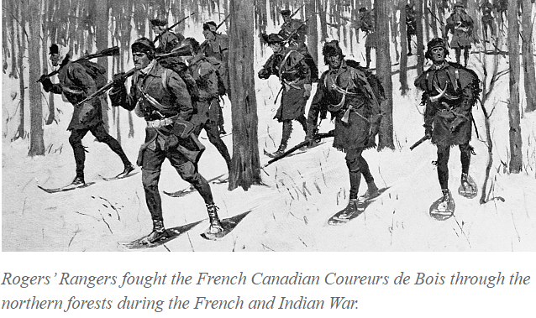
Military service in the Colonies — Alexander Young
  Because the Regimental records were destroyed by the Blitz in WWII London, we’ll never know where in The Highlands another ancestor was from exactly. He enlisted in Scotland at Stirling in the mid 18th Century, and he fought throughout most of the French and Indian Wars in the American British Colonies.
  https://en.wikipedia.org/wiki/77th_Regiment_of_Foot_(Montgomerie%27s_Highlanders)
  https://warfarehistorynetwork.com/daily/military-history/rogers-rangers-the-battle-of-labarbue-creek/
  Young remained a loyal Tory during the Revolutionary War, and was forced to abandon his granted lands in New York state and flee with his family to Canada.
  My branch of his line combined with another Young family (and the Canadian Boyntons), and left Canada for the USA where the combined Young family descendants took advantage of the Homestead Acts (starting in 1862), which offered choice free land, to farm in Kansas near Fort Larned. My great-grandmother, Nellie Young, met Robert Knowles Perry near there.
  https://en.wikipedia.org/wiki/Homestead_Acts
  https://en.wikipedia.org/wiki/Fort_Larned_National_Historic_Site

Slide 19
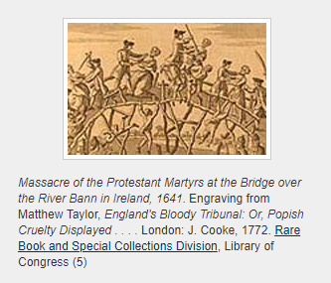
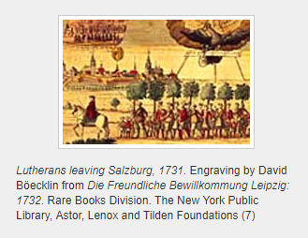
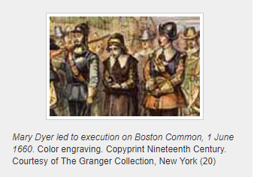
Refugees — War, famine, pogroms, and hopelessness forced others to emigrate — and assimilation after arrival could not possibly be onerous enough to matter, at least to that generation...
But subsequent generations in America were in their turn intolerant of other religious believers. Many Quakers left Boston and went to Rhode Island.
Religion and the Founding of the American Republic
America as a Religious Refuge: The Seventeenth Century, Part 1 https://www.loc.gov/exhibits/religion/rel01.html

Slide 20
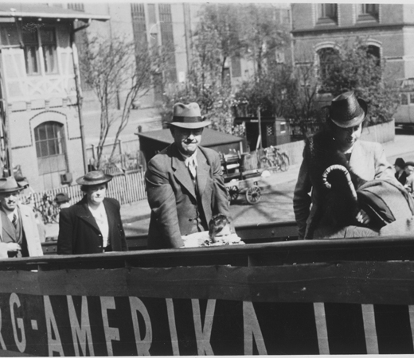
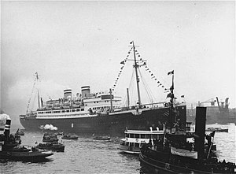
Political barriers to immigration are nothing new
https://en.wikipedia.org/wiki/MS_St._Louis
MS St. Louis was a German ocean liner known for carrying more than 900 Jewish refugees from Germany in 1939. Originally intending to debark in Cuba, they were denied permission to land. The captain, Gustav Schröder, went to the United States and Canada, trying to find a nation to take them in, but both refused. He finally returned the ship to Europe, where various European countries, including Belgium, the Netherlands, the UK, and France, accepted some refugees. Many were later caught in Nazi roundups of Jews in occupied countries, and historians have estimated that approximately a quarter of them died in death camps during World War II.[2] These events, known as the "Voyage of the Damned" in one account, have inspired film, opera, and fiction.
MS St. Louis was a German ocean liner known for carrying more than 900 Jewish refugees from Germany in 1939. Originally intending to debark in Cuba, they were denied permission to land. The captain, Gustav Schröder, went to the United States and Canada, trying to find a nation to take them in, but both refused.
He finally returned the ship to Europe, where various European countries, including Belgium, the Netherlands, the UK, and France, accepted some refugees. Many were later caught in Nazi roundups of Jews in occupied countries, and historians have estimated that approximately a quarter of them died in death camps during World War II.^{[2]} These events, known as the "Voyage of the Damned" in one account, have inspired film, opera, and fiction.
Boarding at Hamburg Harbor
https://en.wikipedia.org/wiki/MS_St._Louis

Slide 21
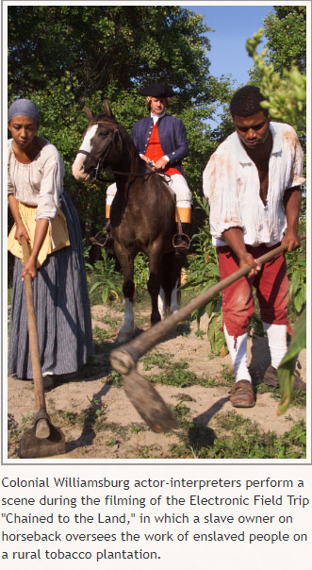
Slavery — gone but not forgotten. Assimilation in America — civil rights — is incomplete to this day. That’s disgraceful.
However, here are some interesting snippets to do with my family history.
Rob the genealogist likes to put me in my place by noting those of my ancestors who were slave-owners. The Rhode Island Perry family usually had a few slaves, according to the recorded wills, until the Abolitionist Movement gained influence. So did the Stouts.
The suspicion is that my Smith grandmother’s family from Missouri prospered by breeding slaves and selling them “down the river” to end up in the cane fields in Louisiana. Slavery importation to the US had been outlawed in 1807, under the sponsorship of Thomas Jefferson, and slowly suppressed. Some saw this law as a business opportunity, and it sheds a new light on the economic factors behind the Civil War.
http://slaveryandremembrance.org/articles/article/?id=A0056

Slide 22

The Green Book – a true story and not that long ago
Green Book Set in the 1960s, it follows a concert tour of the Deep South endured by an African-American classical and jazz pianist and an Italian-American bouncer who served as Shirley's driver and bodyguard.
The film was written by Farrelly, Brian Currie and Vallelonga's son, Nick Vallelonga, based on interviews with his father and Shirley, as well as letters his father wrote to his mother.^{[6]} The film is named after a mid-20th century guidebook for African-American travelers to help them find motels and restaurants that would accept them.
https://en.wikipedia.org/wiki/Green_Book_(film)

Slide 23
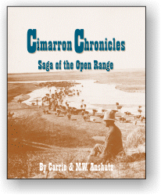
No Man’s Land
Cimarron Chronicles, Saga of the Open Range
That’s my great-grandfather, Robert K. Perry, on the book cover. He was descended from the Connecticut former-Quaker Revolutionary soldier and he married a descendant of the Tory family which came back from Canada to farm the free land near Fort Larned, KS.
After the buffalo were nearly wiped out by commercial hunting, RKP and his brother came from CT to Kansas in the 1870s with a money belt, and bought cattle to graze on the Open Range (“Free Range” it was called then) all over the unfenced, untitled, land in south central Kansas.
A widespread prairie fire caused the cattlemen in the region to move the herds south into what later became the Oklahoma panhandle, but at the time it was “Cimmaron, or “No Man’s Land” as it was not even part of Oklahoma Territory.
My grandfather was born in a sod house near what is now Beaver, OK.
http://www.kansashistory.us/cimchron.html

Slide 24
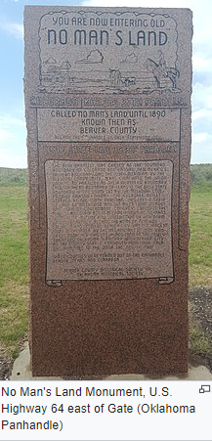
Was assimilation always easy? Seldom.
Those of my ancestors usually had it easier if they immigrated with status and wealth, but not always. Penelope’s party of immigrants were (in most versions of the tale) connected to the Governor, but her first husband was killed by Indians right after they landed, and she suffered horribly, but lived long and had many New Jersey descendants named Stout.
Two toddlers of the Stout family were killed and scalped in Kentucky.
The Young family of my Perry great-grandmother, Nellie of the T6, was originally from Northern Ireland (and likely Scotland before that). One branch of the family went through Canada to Australia to hunt for gold, and left Nellie a modest inheritance.
https://en.wikipedia.org/wiki/Oklahoma_Panhandle

Slide 25
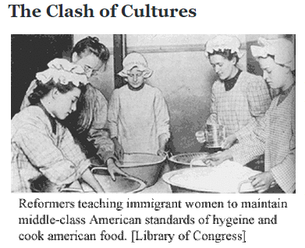
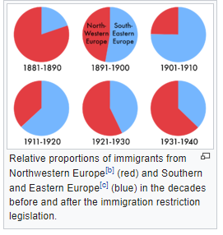
Prejudice against immigrants by my family
Nellie Perry, my great-grandmother in Cimarron, was a woman of some asperity who, according to family tales, lamented the trials of forever training some Irish immigrant girl to be an acceptable servant at the T6 Ranch HQ, only to see the ungrateful wench get married to some cowboy and the whole process had to begin again. Each ethnic wave of immigrants suffered prejudice.
My grandfather, when courting his Smith wife, promised her she would always have immigrant servants to do the laundry and cleaning. He meant Mexican immigrants, of course, and he called his best horse “Little Nigger.”
https://anti-immigrant.weebly.com/1920s-resurgence.html
https://en.wikipedia.org/wiki/Immigration_Act_of_1924

Slide 26

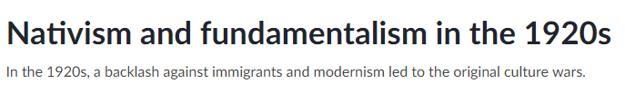
Progression of assimilation from ugly death to prejudice
It’s true that horrible things have happened to immigrants all through the history of immigration. Some still suffer violence and that is inexcusable. But not generally. We’re all human; make the best of it, not the worst.
  When I was in High School in Kansas in the 1950s, the Rest Homes looked for German-speaking staff, because many of the old people lost their English.
  In South Dakota, which contains several large Native American reservations, the land was settled by immigrant Poles and Scandinavians. My mother-in-law said when she was a girl the small towns and farms had social gatherings regardless of which accents mangled the common language of English; the only families to be scorned were those who were shiftless, meaning mostly those not land owners. The Native Americans she wouldn’t talk about.
http://www.nbcnews.com/id/24714378/ns/us_news-gut_check/t/s-s-immigration-defining-whiteness/#.XFjRzFzYrDc
https://www.khanacademy.org/humanities/us-history/rise-to-world-power/1920s-america/a/transformation-and-backlash-cnx

Slide 27
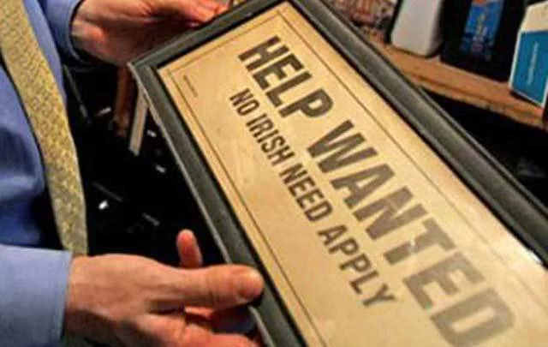
Should assimilation be total, then? Everybody indistinguishable as to morphology, accent, and culture? No! What a waste!
The constant absorption of immigrants defines our national destiny;
it’s what makes us what we are.
On the one hand, it has caused great suffering, Indians forced off their land, and terrible conflicts between rival ethnic groups.
On the other hand, successful assimilation makes us incredibly strong and creative, as each group contributes to the melting pot but retains some of its original culture.
Now that European immigration has tapered off, and those fearful of strangers see threats because recent newcomers have more varied skin tones and languages and religions, calm down — the assimilation is just widening.
https://www.irishcentral.com/https://www.irishcentral.com/uploads/article/4427/cropped_MI-no-irish-sign-1.jpg?t=1526815369

Slide 28
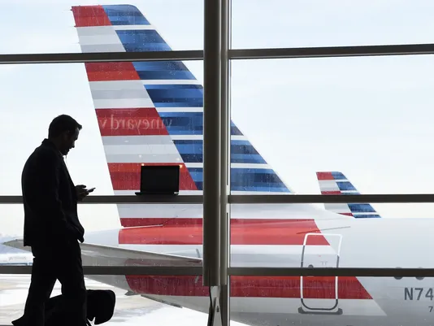
Transport
“Native” Americans walked across the Bering Land Bridge
The first Europeans came on sailing ships, some to conquer and loot, or “planted” to hold the conquest
  Many more sailed to escape from religious persecution and poverty
  Some were “imported” as slaves or forced labor
Then immigrants came in steamships, mostly from Europe
And now they fly in airplanes, many from Asia
Photo: Susan Walsh, AP

Slide 29
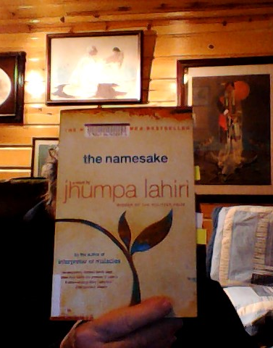
Literature Review
— 5th Example
The Airplane Immigrants are often highly skilled professionals, many of whom studied at USA universities and so were already rigorously selected to be the brightest and the best.
“…So many Cambrige Bengalis gathered on Saturday evenings, …the parents conversing in the Bengali their children don’t speak among themselves… They learn to roast turkeys, albeit rubbed with garlic and cumin and cayenne.”
Lahiri, Jhumpa (2004). the namesake. Houghton, Mifflin, Harcourt Publishing Company, 3 Park Avenue, 19th Floor, New York, NY 10016. ISBN: 0-395-927218
https://en.wikipedia.org/wiki/The_Namesake

Slide 30
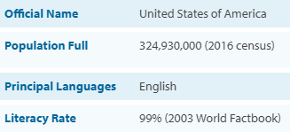
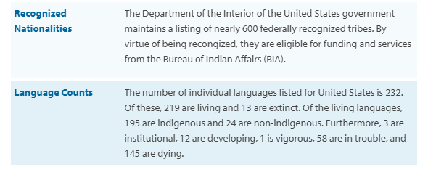
For the record
https://www.ethnologue.com/country/US

Slide 31

We are being surpassed:
Canada’s Ruthlessly Smart Immigration Policy
Given the xenophobia now sweeping the rest of the West, Canadians’ openness might seem bizarrely magnanimous. In fact, it’s a reasonable attitude rooted in national interest. Canada’s foreign-born population is more educated than that of any other country on earth. Immigrants to Canada work harder, create more businesses and typically use fewer welfare dollars than do their native-born compatriots.
Indeed, their contributions go all the way to the top. Two of the last three governors-general — Canada’s ceremonial heads of state — were born abroad (one in Haiti and one in Hong Kong), and the current cabinet has more Sikhs (four) than the cabinet of India. Quoted from: https://www.nytimes.com/2017/06/28/opinion/canada-immigration-policy-trump.html
https://globalnews.ca/news/3836805/340k-immigrants-per-year-by-2020-government-unveils-new-immigration-targets/

Slide 32
Acknowledgements
The bibliographical citations, mostly from online sources, are on the pages near the items they reference.
Rob Wilcox has compiled my family genealogy and updates it every year or so, along with several others for his family and friends, as a contribution to the knowledge base in Ancestry.com, and I pay for our subscription to the international segment of Ancestry.com. Copy and paste URLs for Google Drive into your browser for the relevant online archives; however, the Ancestry.com won’t work unless you’re a member.
  https://drive.google.com/drive/u/0/folders/0BzAxreAuL2eDb0VZM0lwUHV2cTQ
  https://drive.google.com/drive/u/0/folders/0BzAxreAuL2eDOGtjN3RQTXpHMm8
  https://www.ancestry.com/family-tree/tree/12795042/family

